Slide 1


DEPARTMENT OF INFORMATION TECHNOLOGY
MADRAS INSTITUTE OF TECHNOLOGY
ANNA UNIVERSITY-CHENNAI
  SECOND REVIEW
Explainable Hierarchical Temporal Graph Neural Network for Early Intrusion Detection in 5G/6G Networks
TEAM MEMBERS: GUIDED BY
Kumaran S (2023506091) Dr. G. Rajesh
Gnanendhiran V (2023506103) Associate Professor,
Janardhanam B (2023506108) Department of Information Technology
Nandha Kumar V (2023506308)

Slide 2
Problem Statement
5G wireless networks generate highly dynamic and heterogeneous traffic, making intrusion patterns difficult to detect using conventional IDS techniques.
Traditional machine-learning approaches mainly analyze individual traffic features and may not capture relationships between communicating network entities.
Existing detection approaches may therefore face limitations in identifying early and evolving attack behavior.
Objective
To develop an Explainable Hierarchical Temporal Graph Neural Network (HTSTCL-GNN) for early detection of benign and malicious activities in 5G wireless systems by learning spatial and temporal characteristics of network traffic.

Slide 3
REVIEW 1 – REVIEW 2
Review-1 | Review-2
5G-NIDD Dataset: 1,215,890 flow records, 91 features, 2 classes | HTSTCL-GNN: Proposed model developed using GAT + 2-layer GRU + hierarchical attention + FC classifier
Preprocessing: StandardScaler applied using the Python training scaler | Training: Model trained using 48,635 graph sequences
Progressive Windows: 5 flow records/window → 243,178 graphs | Validation : 7,295 validation + 98.44% Validation accuracy
Graph: 5 nodes + 10 directed edges/graph | Testing : 7,296 test sequences; 98.41% test accuracy
Temporal Sequence: 5 graphs/sequence → 48,635 sequences | MATLAB 5G Environment: 3 Base Stations + 30 UEs
Class Distribution: 17,738 benign + 30,897 malicious sequences | Simulation Traffic: 1002 samples — 408 benign + 594 malicious
Input Dimension: 5 × 91 features × 5 graphs | Prediction: MATLAB-generated 5G traffic classified using the trained HTSTCL-GNN

Slide 4
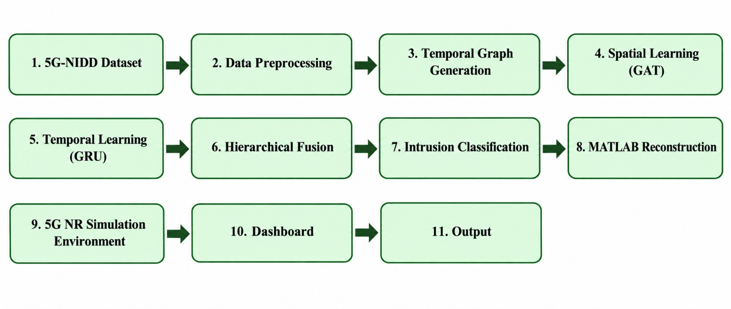
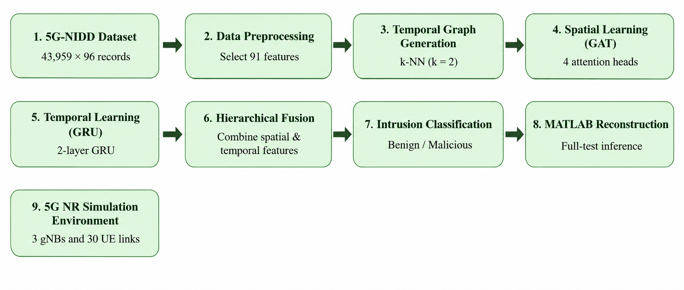
Work Flow

Slide 5
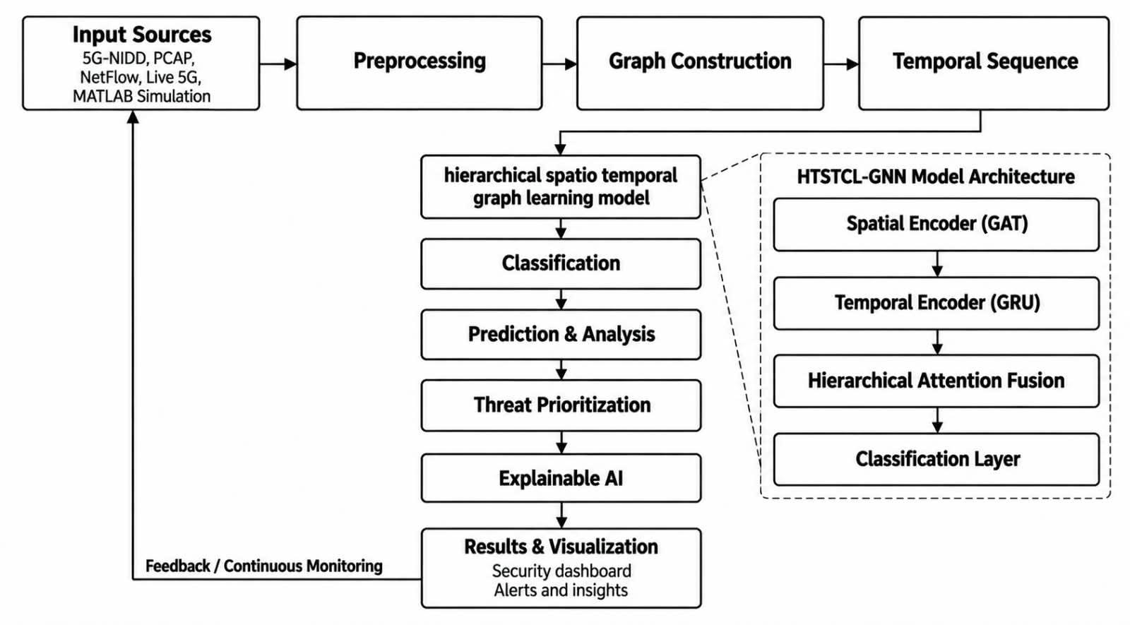
Architecture

Slide 6
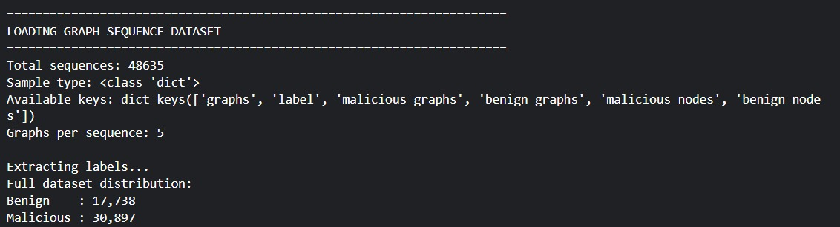
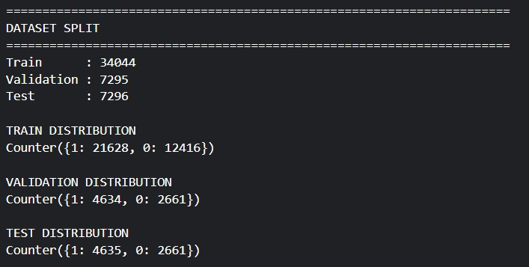
Implementation Details
Fig. 1. Dataset Split

Slide 7
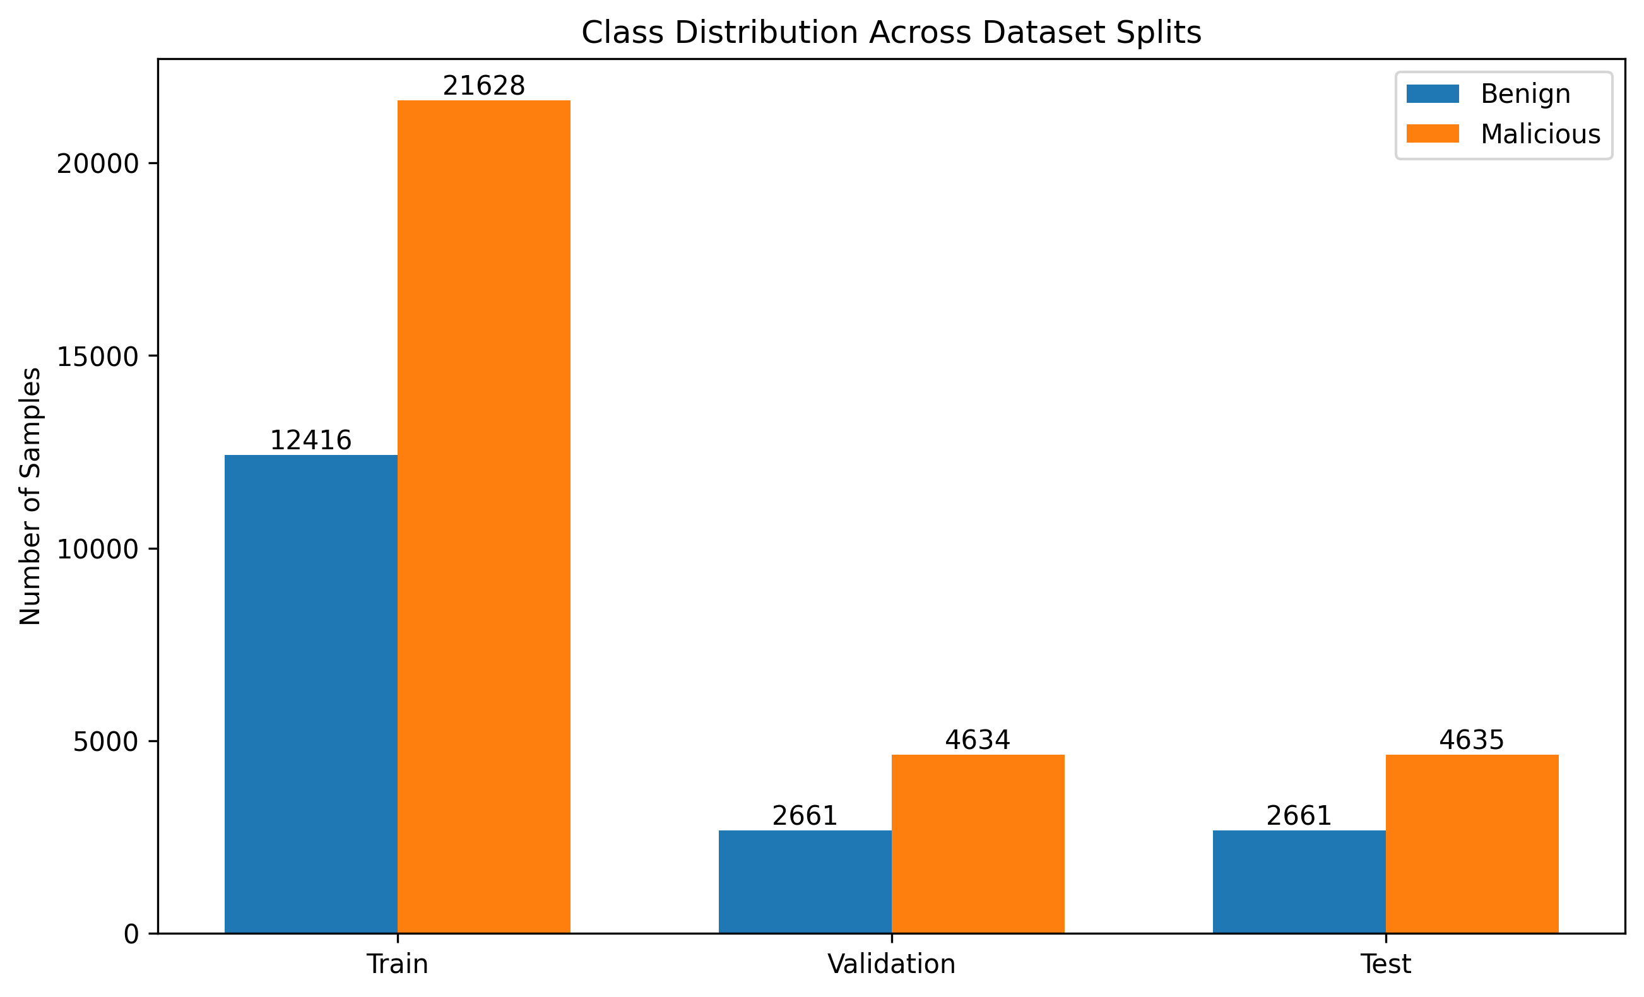

Slide 8
Parameter Details
Parameter | Value
Dataset | 5G-NIDD
Input Features | 91
Training/ Validation / Test Sequences | 34,044 + 7,295 + 7295
Total Temporal Sequences | 48,635
Epochs | 30
Batch Size | 32
Learning Rate | 0.001

Slide 9
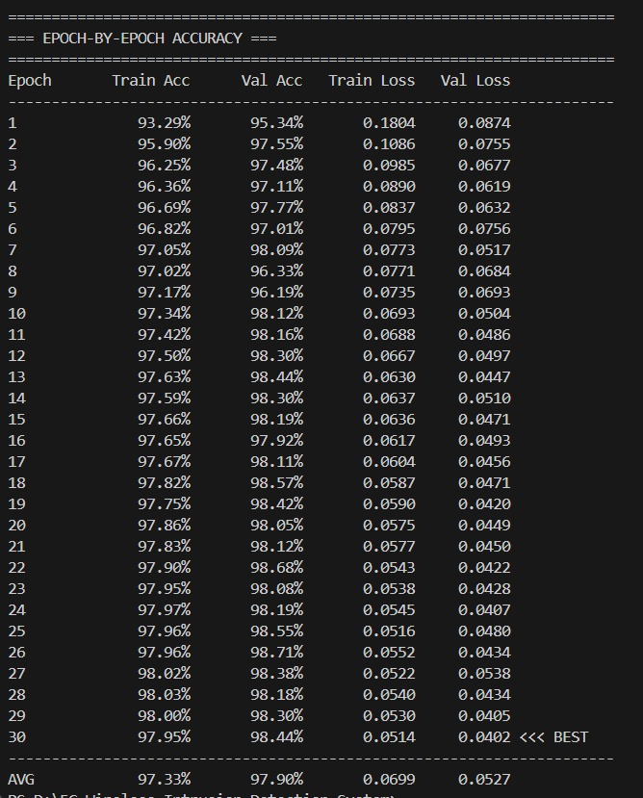
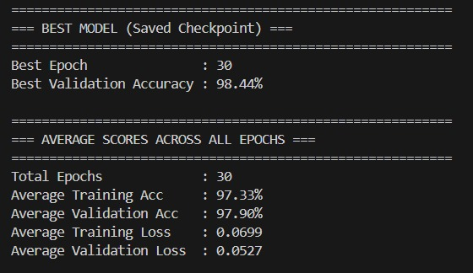
Evaluation Results (Training) :

Slide 10
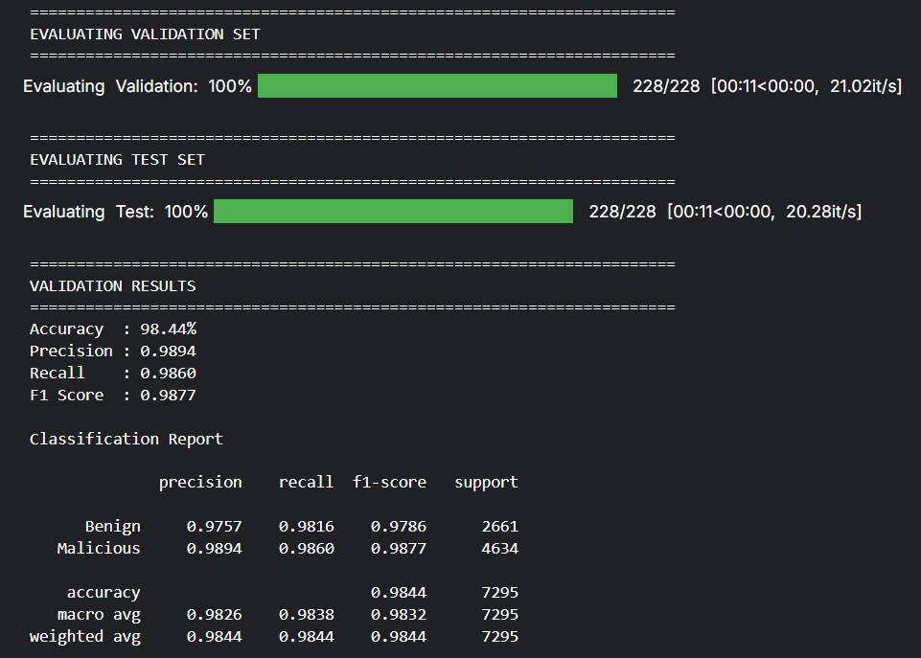
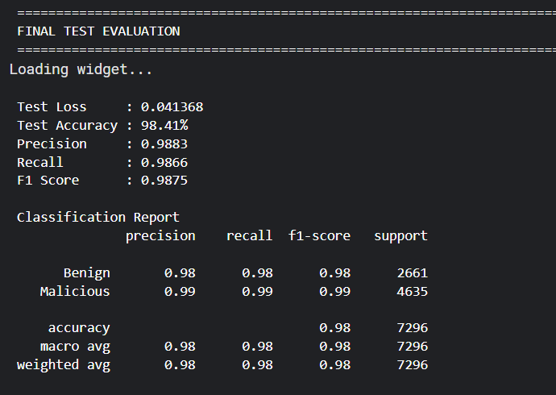
Evaluation Results (Validation & Test) :
Fig. 2. Validation Results
Fig. 3. Test Results

Slide 11
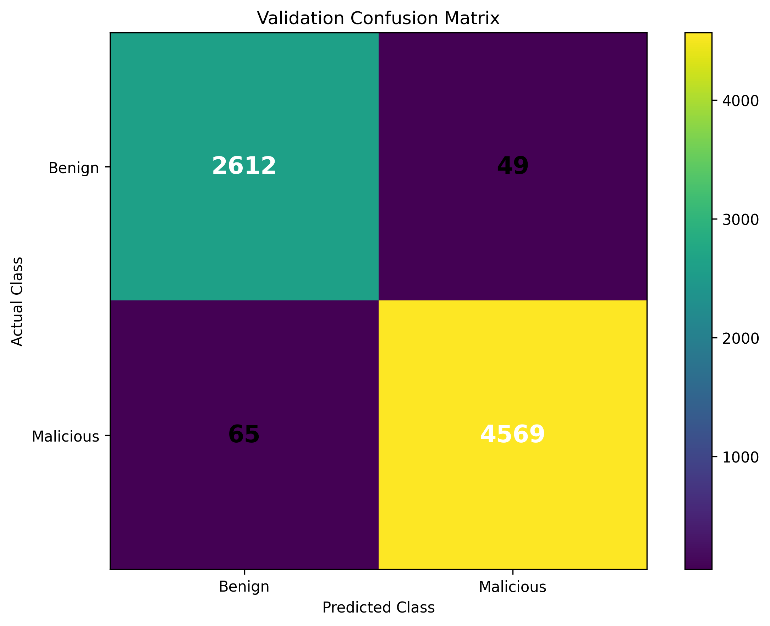
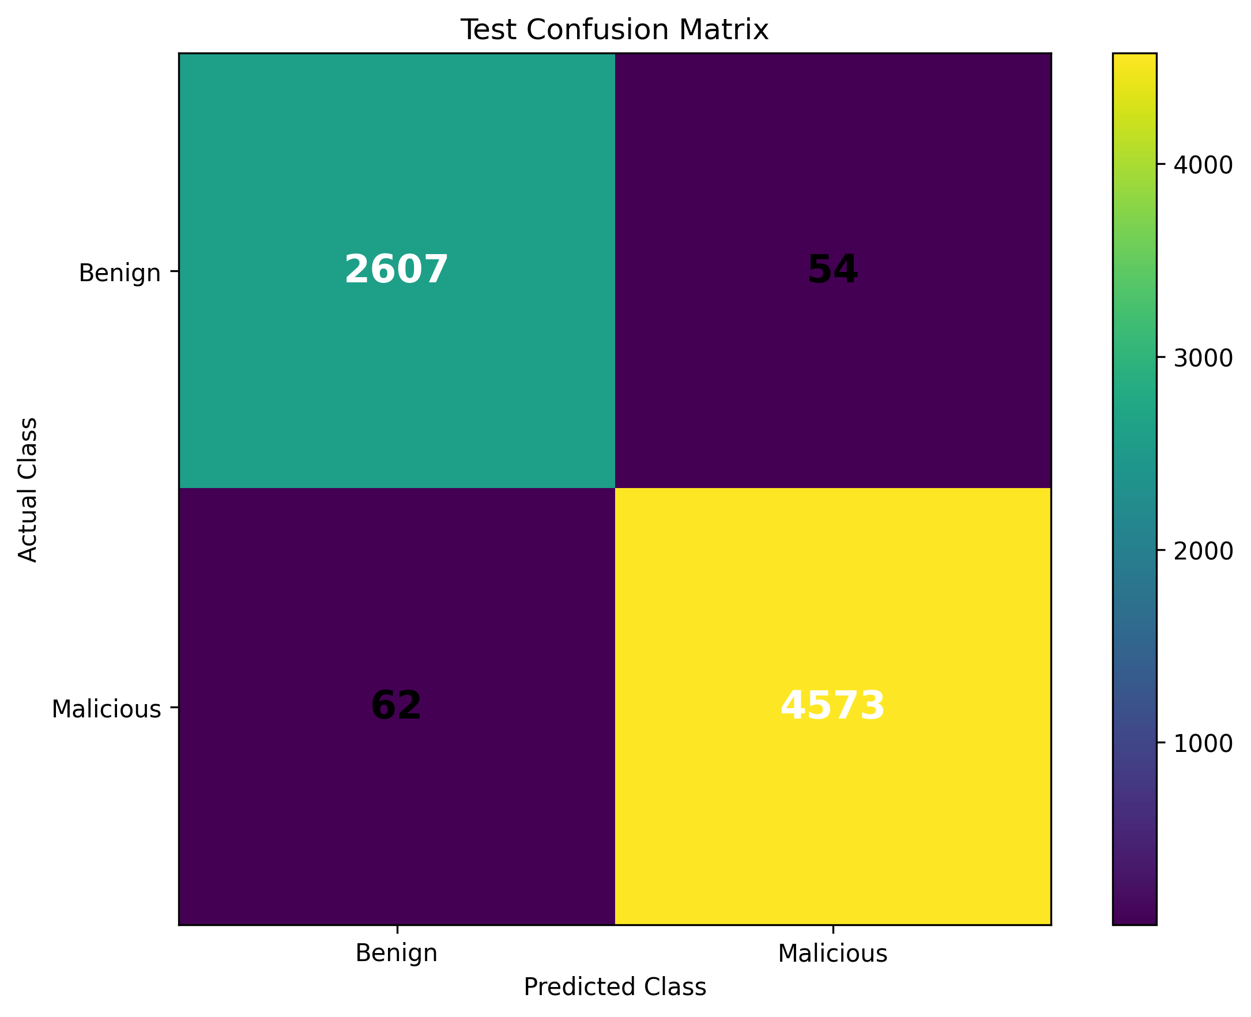
Validation And Test Confusion Matrix

Slide 12
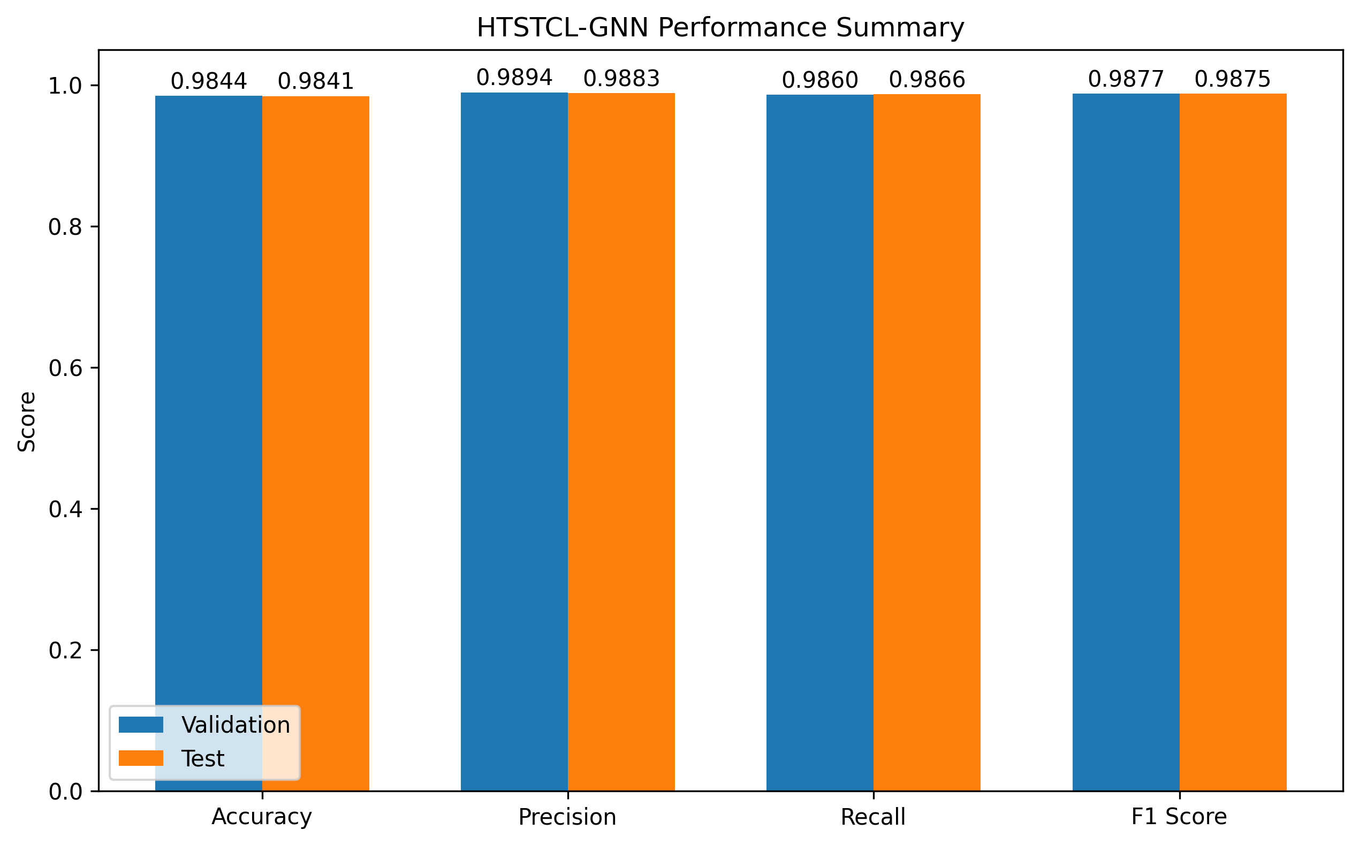
Final Metrics Summary

Slide 13
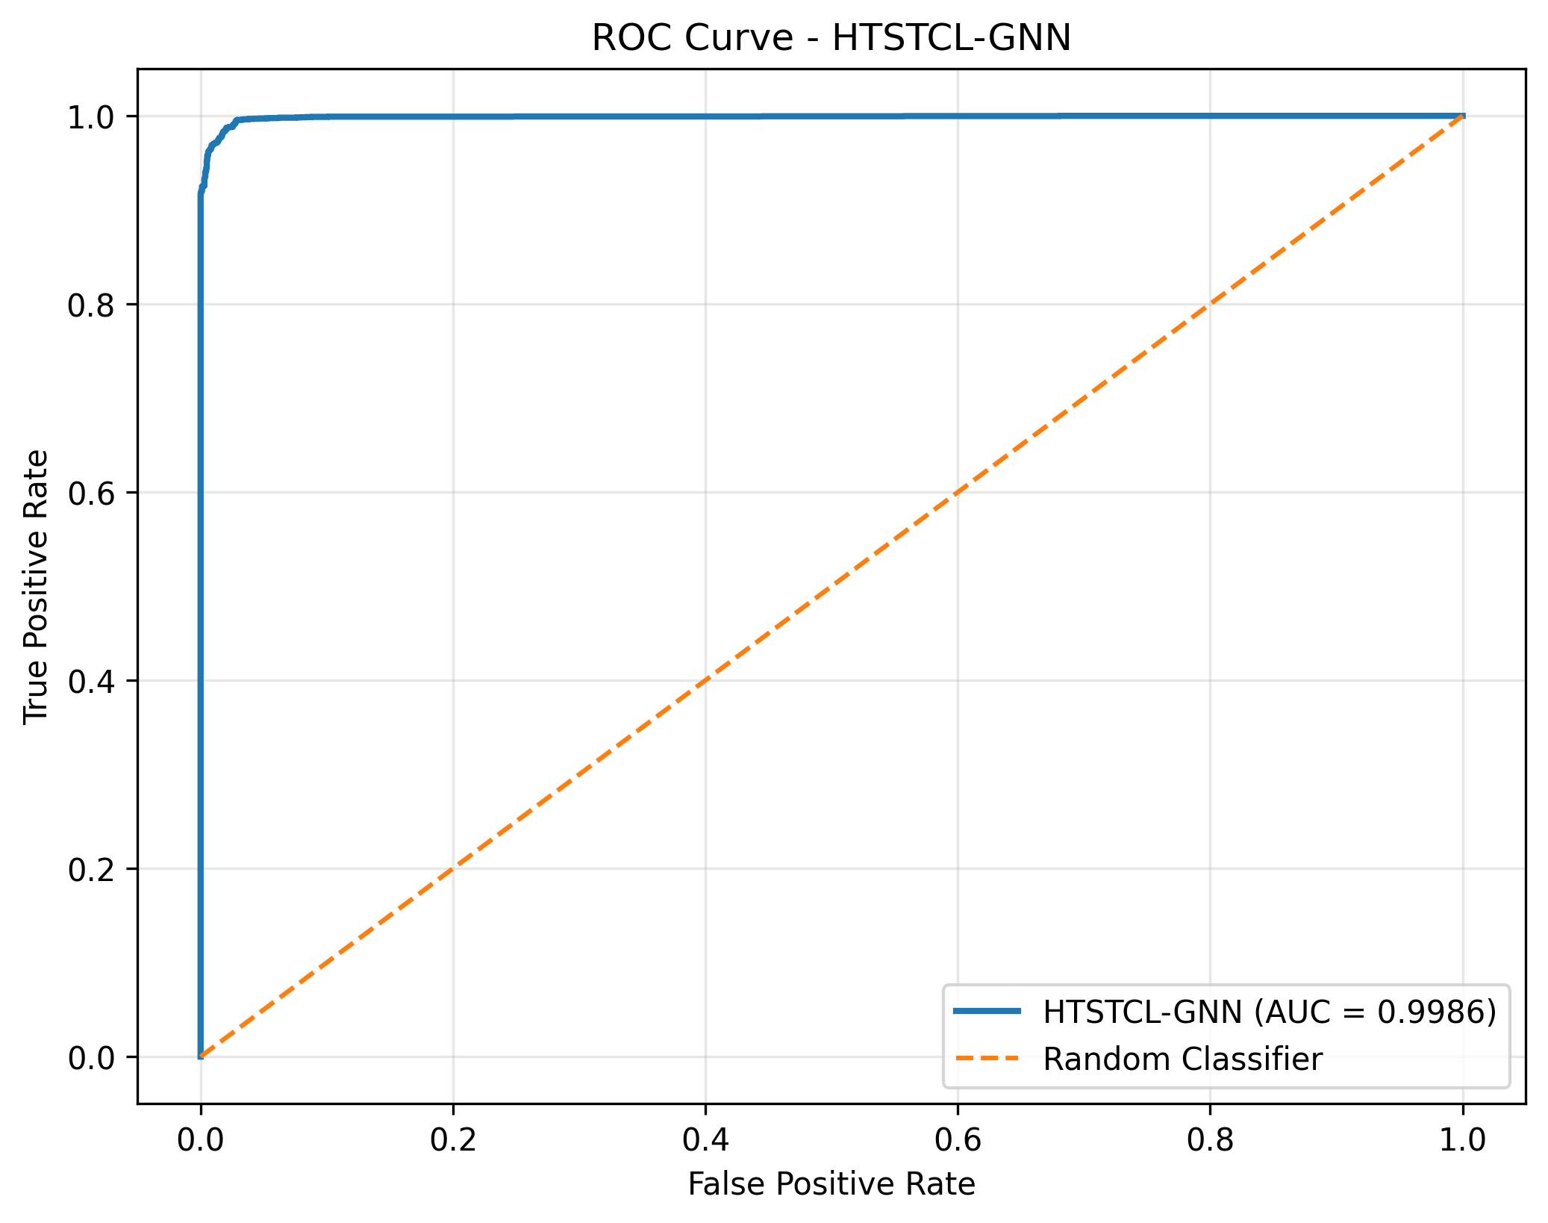
Fig. 4. ROC and AUC

Slide 14
Configuration Details
Parameter | Value
MATLAB Version | R2024b
Network | 5G NR-inspired simulation
Topology Type | Multi-Cell Triangular
Number of gNBs | 3
Number of UEs | 30
UE per gNB | 10
Carrier Frequency | 3.50 GHz
gNBs Tx Power | 43dBm (~20W)
No.of.Benign UEs | 12
No.of.Malicious UEs | 18
gNB Antenna Height | 25m
UE Antenna Height | 1.5m

Slide 15
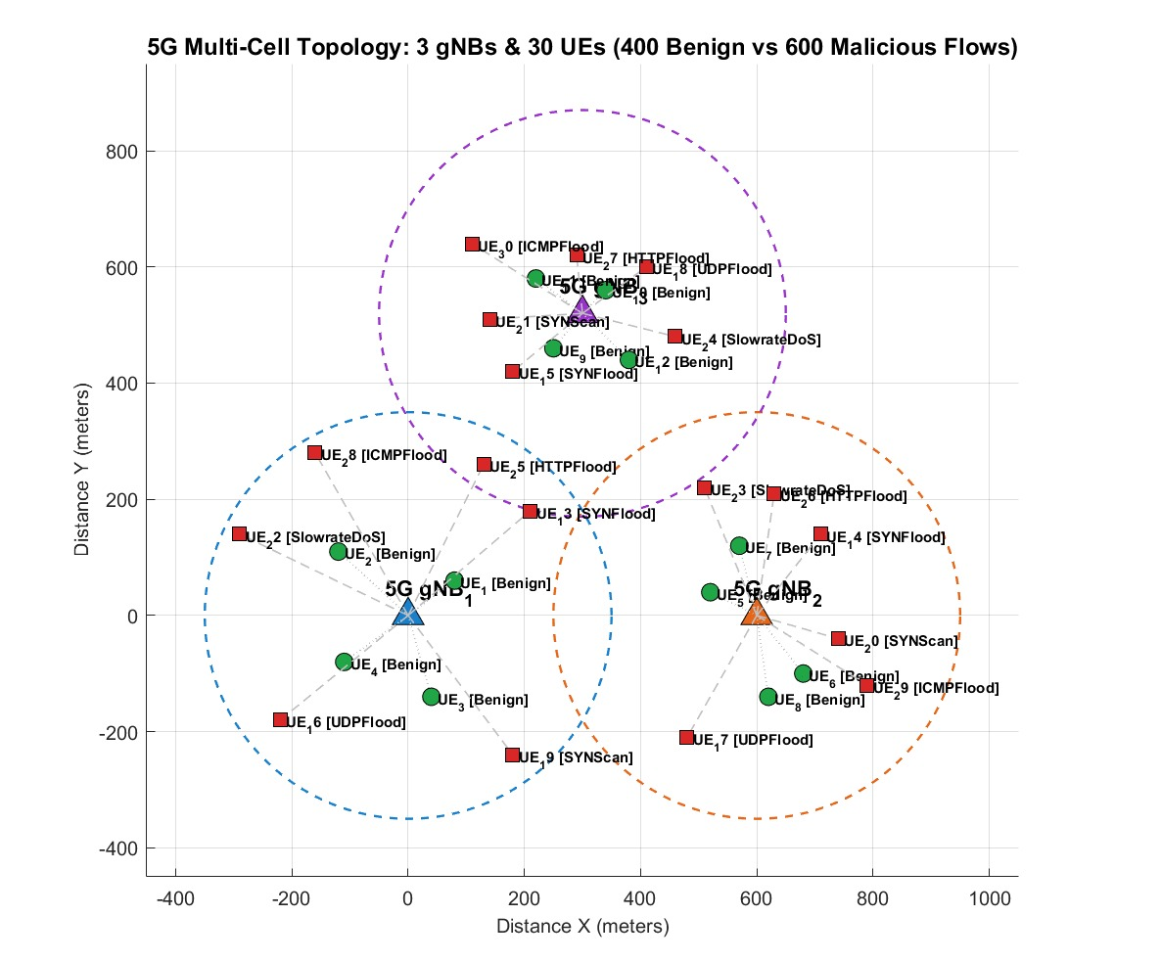
Fig. 5. MATLAB 5G NR simulation topology containing 3 gNB base stations and 30 UE links.

Slide 16
Algorithm
Input:
Graph sequences G = {G1, G2, ..., GT},
node features Xt,
graph edges Et,
labels Y,
learning rate η,
batch size B,
epochs E
Output:
Trained model parameters θ
Predicted IDS class Ŷ
1.Initialize HTSTCL-GNN model parameters θ
for epoch = 1 to E do
Divide graph sequences into batches of size B
2. for each batch do
Initialize spatial embeddings
for each graph snapshot Gt do
Extract:
Gt = (Vt, Et, Xt)
3. Apply Spatial Encoder using Graph Attention:
Hs(t) = GATConv(Xt, Et)
4. Apply activation and normalization:
Hs(t) = BatchNorm(ReLU(Hs(t)))
end for
5. Form temporal sequence:
Hs = {Hs(1), Hs(2), ..., Hs(T)}
Apply Temporal Encoder:
Htemp = GRU(Hs)
Project temporal features:
Ht = Linear(Htemp)
6. Compute hierarchical attention weights:
αs = SpatialAttention(Hs)
αt = TemporalAttention(Ht)
7. Perform Hierarchical Fusion:
Hf = Fusion(αs · Hs, αt · Ht)
Apply Projection Head:
Hp = Linear(ReLU(Hf))
Apply Dropout for regularization
8. Generate classification output:
Z = Classifier(Hp)
. Update model parameters:
θ ← θ − η · ∇θL
end for

Slide 17
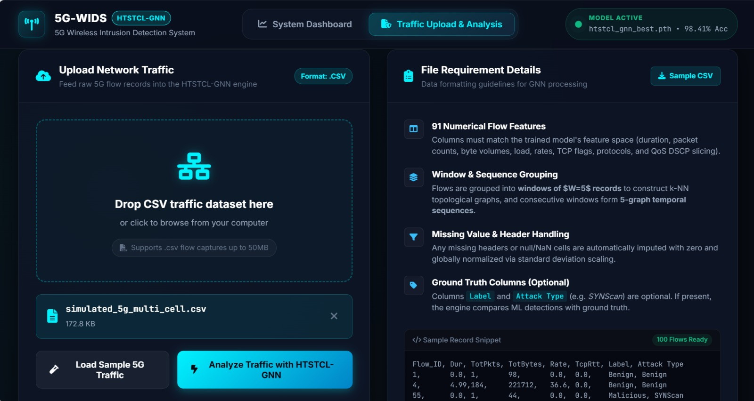
DASHBOARD Results

Slide 18
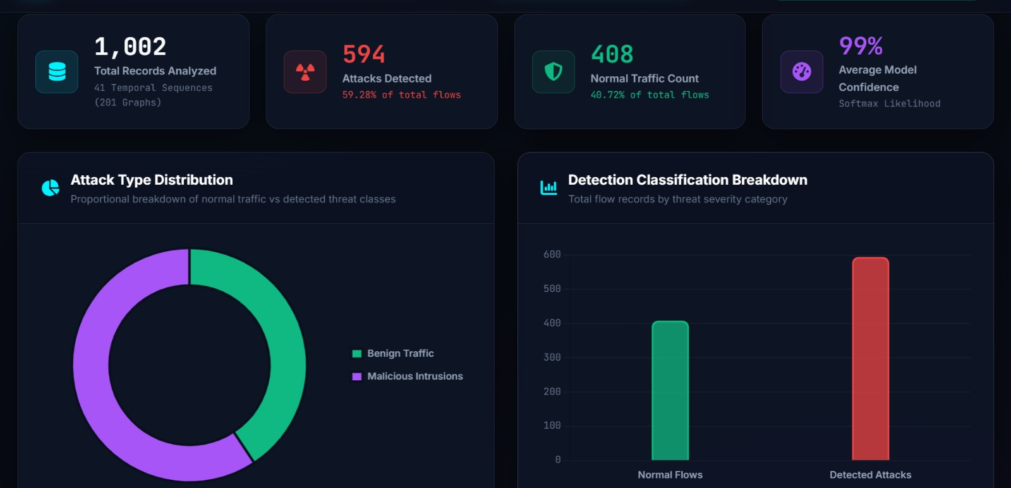

Slide 19
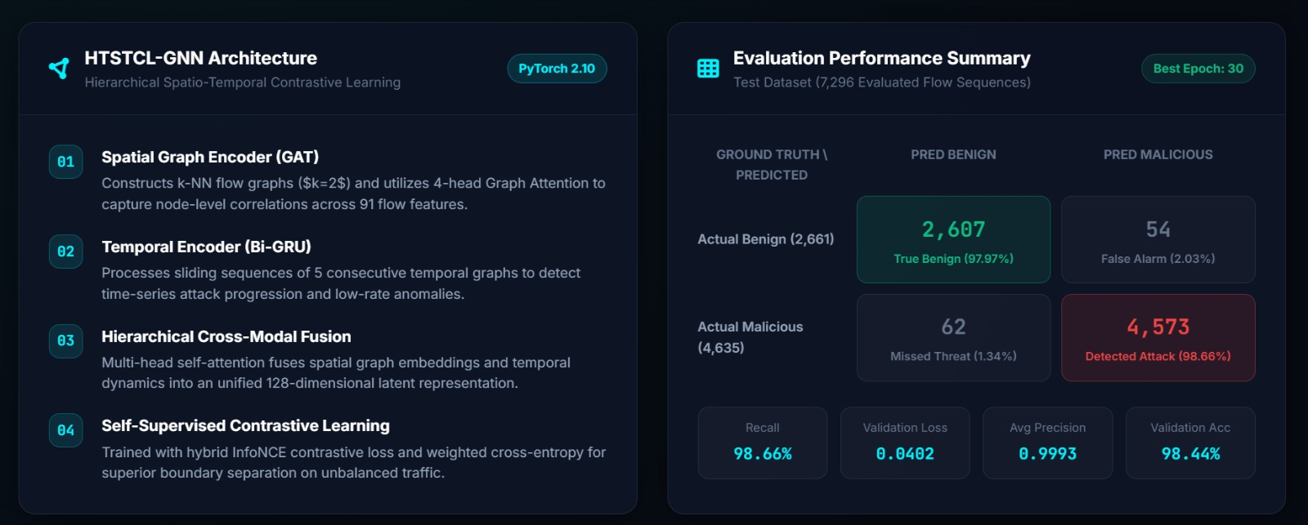
Evaluation Performance

Slide 20
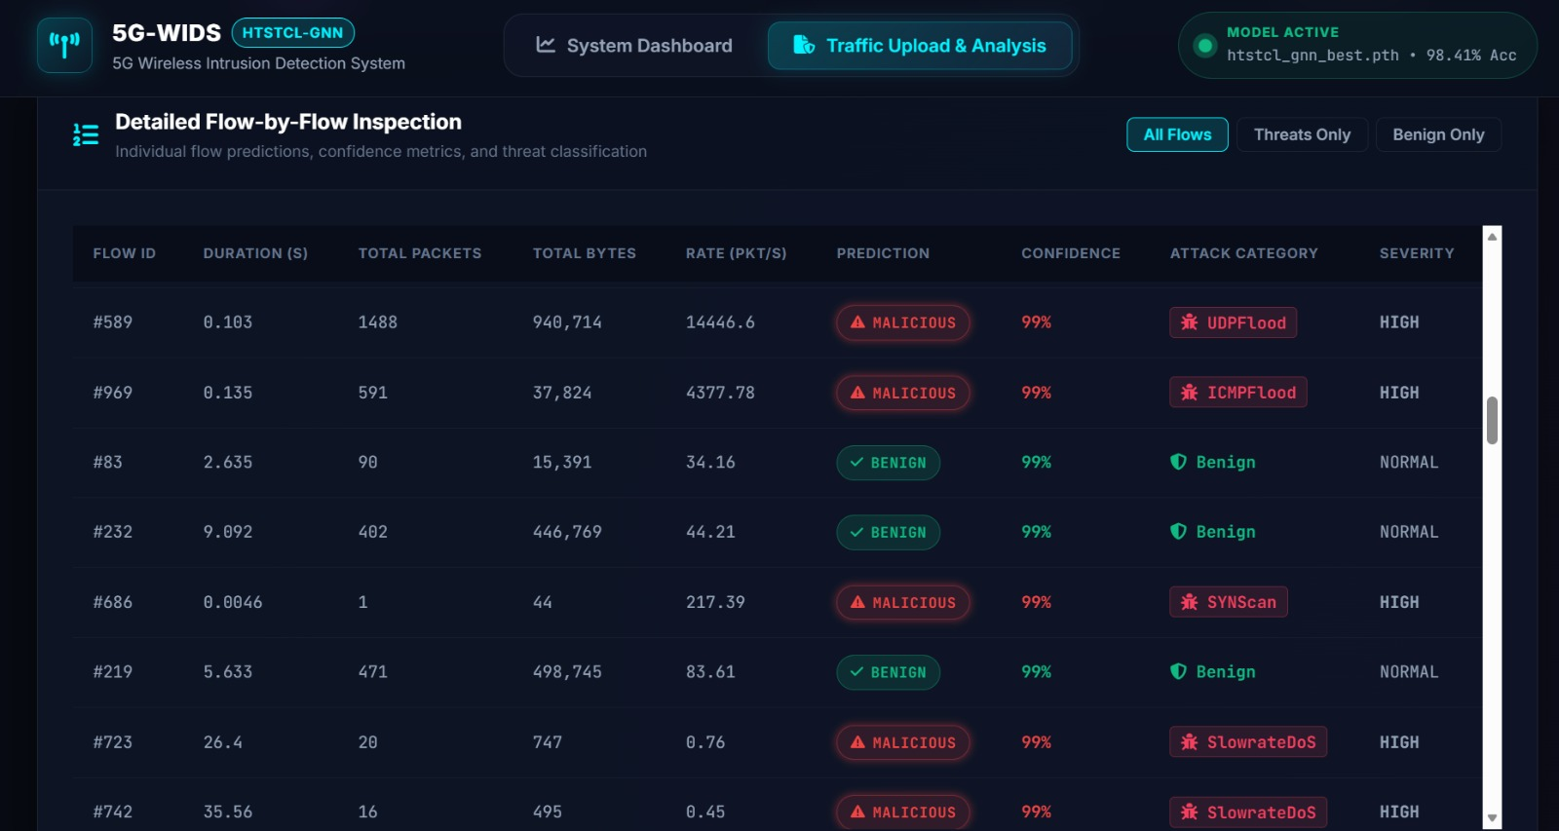
Flow by Flow Inspection

Slide 21
THANK YOU

